Slide 1
Mapping down to 0, ..., M – 1

Slide 2
Outline
Previously, we considered means for calculating 32-bit hash values
Explicitly defined hash values
Implicitly calculated hash values
Practically, we will require a hash value on the range 0, ..., M – 1:
The modulus operator %
Review of bitwise operations
The multiplicative method

Slide 3
The hash process
9.3.1
Object
32-bit integer
Modulus, mid-square, multiplicative, Fibonacci
Map to an index 0, ..., M – 1
Deal with collisions
Chained hash tables
Open addressing

Slide 4
Properties
9.3.2
Necessary properties of this mapping function h_{M} are:
2a. Must be fast: Θ(1)
2b. The hash value must be deterministic
Given n and M, h_{M}(n) must always return the same value
2c. If two objects are randomly chosen, there should be only a one-in-M chance that they have the same value from 0 to M – 1

Slide 5
Modulus operator
9.3.2
Easiest method: return the value modulus M
unsigned int hash_M( unsigned int n, unsigned int M ) {
return n % M;
}
Unfortunately, calculating the modulus (or remainder) is expensive
We can simplify this if M = 2^{m}
We can use logic operations
We will review bitwise operations: left and right shift and bit-wise and

Slide 6
The bitwise operators: & << >>
9.3.2.1
Suppose I want to calculate
7985325 % 100
The modulo is a power of ten: 100 = 10²
In this case, take the last two decimal digits: 25
Similarly, 7985325 % 10³ = 325
We set the appropriate digits to 0:
0000025 and 0000325

Slide 7
The bitwise operators: & << >>
9.3.2.1
The same works in base 2:
100011100101₂ % 10000₂
The modulo is a power of 2: 10000₂ = 2⁴
In this case, take the last four bits: 0101
Similarly, 100011100101₂ % 1000000₂ == 100101,
We set the appropriate digits to 0:
000000000101 and 000000100101

Slide 8
The bitwise operators: & << >>
9.3.2.1
To zero all but the last n bits, select the last n bits using bitwise and:
1000 1110 0101₂ & 0000 0000 1111₂ → 0000 0000 0101₂
1000 1110 0101₂ & 0000 0011 1111₂ → 0000 0010 0101₂

Slide 9
The bitwise operators: & << >>
9.3.2.1
Similarly, multiplying or dividing by powers of 10 is easy:
7985325 * 100
The multiplier is a power of ten: 100 = 10²
In this case, add two zeros: 798532500
Similarly, 7985325 / 10³ = 7985
Just add the appropriate number of zeros or remove the appropriate number of digits

Slide 10
The bitwise operators: & << >>
9.3.2.1
The same works in base 2:
100011100101₂ * 10000₂
The modulo is a power of 2: 10000₂ = 2⁴
In this case, add four zeros: 1000111001010000
Similarly, 100011100101₂ / 1000000₂ == 100011

Slide 11
The bitwise operators: & << >>
9.3.2.1
This can be done mechanically by shifting the bits appropriately:
1000 1110 0101₂ << 4 == 1000 1110 0101 0000₂
1000 1110 0101₂ >> 6 == 10 0011₂
Powers of 2 are now easy to calculate:
1₂ << 4 == 1 0000₂ // 2⁴ = 16
1₂ << 6 == 100 0000₂ // 2⁶ = 64

Slide 12
Modulo a power of two
9.3.2.1
The implementation using the modulus/remainder operator:
unsigned int hash_M( unsigned int n, unsigned int m ) {
return n & ((1 << m) – 1);
}

Slide 13
Modulo a power of two
9.3.2.2
Problem:
Suppose that the hash function h is always even
An even number modulo a power of two is still even
Example: memory allocations are multiples of word size
On a 64-bit computer, addresses returned by new will be multiples of 8
Thus, if x ≠ y, h(x) ≠ h(y)
However, the probability that h_{M}( h(x) ) = h_{M}( h(y) ) is one in M/8
This is not one in M

Slide 14
Modulo a power of two
9.3.2.2
For some objects, it is worse:
Instance of Single_node<int> on ecelinux always have 10000 as the last five bits
This increases the probability of a collision to one in M/32
Fortunately, the multiplicative method resolves this issue

Slide 15
Multiplication techniques
9.3.3
We need to obfuscate the bits
The most common method to obfuscate bits is multiplication
Consider how one bit can affect an entire range of numbers in the result:
10100111
× 11010011
10100111
10100111
10100111
10100111
+ 10100111 .
1000101110100101
C++ truncates the product of two n-bit
numbers to n bits
The avalanche effect: when changing one bits has the potential of affecting all bits in the result:
10100011 × 11010011
= 1000011001011001

Slide 16
Multiplication techniques
9.3.3
Multiplication can be used in encryption as with IDEA:
unsigned short a, b, c, d; // 64 bit number broken into four 16 bits
unsigned short z[9][6]; // 52 numbers based on key (2 unused)
for ( int i = 0; i < 8; ++i ) {
a *= z[i][0]; b += z[i][1]; c += z[i][2]; d *= z[i][3];
e = z[i][4]*(a^c);
f = ( e + (b^d) )*z[i][5];
e += f;
a ^= f; tmp = b; b = c^f; c = tmp^e; d ^= e;
}
a *= z[8][0]; b += z[8][1]; c += z[8][2]; d *= z[8][3];
Xuejia Lai and James Massey

Slide 17
The multiplicative method
9.3.3
Multiplying by a fixed constant is a reasonable method
Take the middle m bits of Cn:
unsigned int const C = 581869333; // some number
unsigned int hash_M( unsigned int n, unsigned int m ) {
unsigned int shift = (32 – m)/2;
return ((C*n) >> shift) & ((1 << m) – 1);
}

Slide 18
The multiplicative method
9.3.3
Suppose that the value m = 10 (M = 1024) and n = 42
const unsigned int C = 581869333; // some number
unsigned int hash_M( unsigned int n, unsigned int m ) {
unsigned int shift = (32 – m)/2;
return ((C*n) >> shift) & ((1 << m) – 1);
}

Slide 19
The multiplicative method
9.3.3.1
m = 10
n = 42
First calculate the shift
const unsigned int C = 581869333; // some number
unsigned int hash_M( unsigned int n, unsigned int m ) {
unsigned int shift = (32 – m)/2;
return ((C*n) >> shift) & ((1 << m) – 1);
}
shift = 11

Slide 20
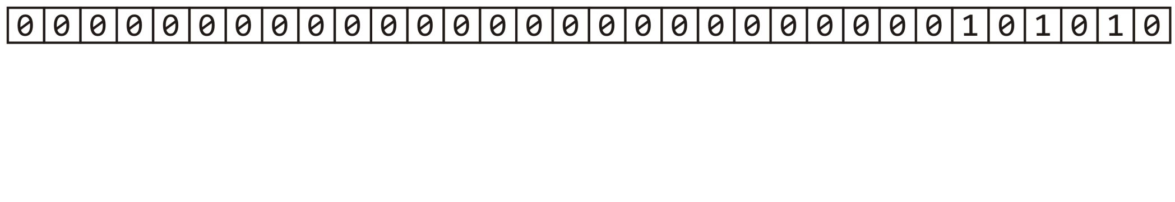
The multiplicative method
9.3.3.1
m = 10
n = 42
Next, n = 42 or 101010₂
const unsigned int C = 581869333; // some number
unsigned int hash_M( unsigned int n, unsigned int m ) {
unsigned int shift = (32 – m)/2;
return ((C*n) >> shift) & ((1 << m) – 1);
}
shift = 11

Slide 21
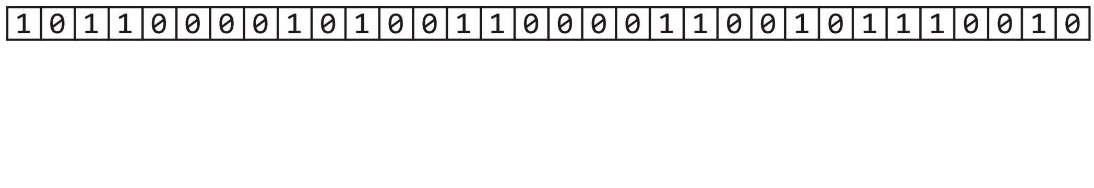
The multiplicative method
9.3.3.1
m = 10
n = 42
Calculate Cn
const unsigned int C = 581869333; // some number
unsigned int hash_M( unsigned int n, unsigned int m ) {
unsigned int shift = (32 – m)/2;
return ((C*n) >> shift) & ((1 << m) – 1);
}
shift = 11

Slide 22
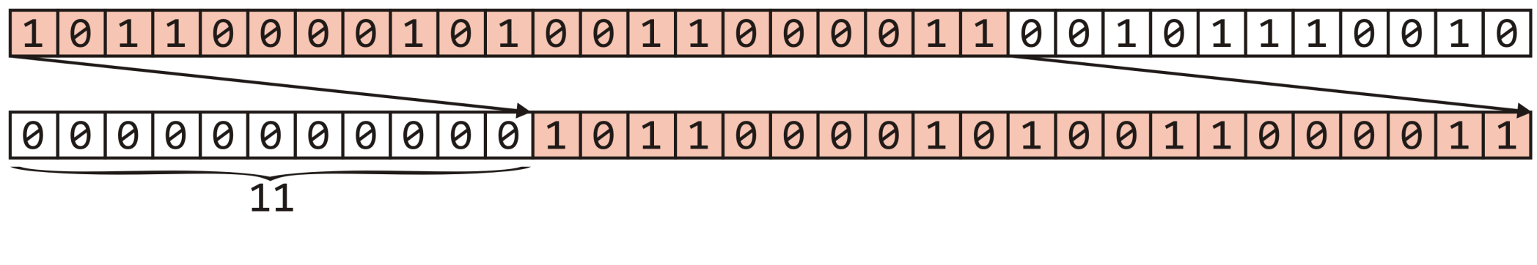
The multiplicative method
9.3.3.1
m = 10
n = 42
Right shift this value 11 bits—equivalent to dividing by 2¹¹
const unsigned int C = 581869333; // some number
unsigned int hash_M( unsigned int n, unsigned int m ) {
unsigned int shift = (32 – m)/2;
return ((C*n) >> shift) & ((1 << m) – 1);
}
shift = 11

Slide 23
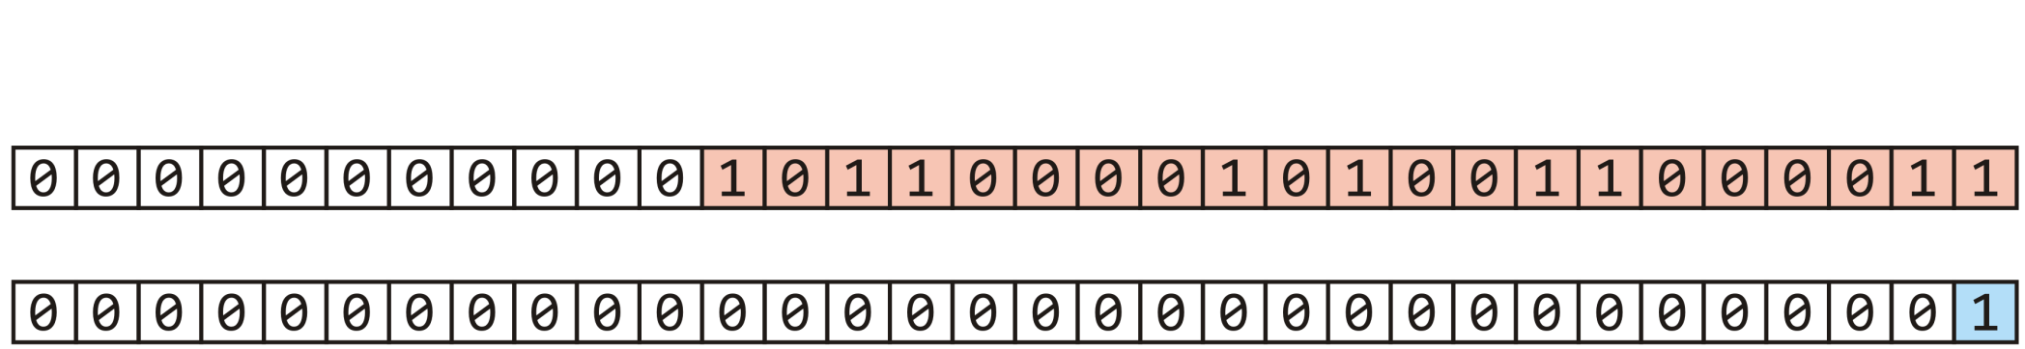
The multiplicative method
9.3.3.1
m = 10
n = 42
Next, start with 1
const unsigned int C = 581869333; // some number
unsigned int hash_M( unsigned int n, unsigned int m ) {
unsigned int shift = (32 – m)/2;
return ((C*n) >> shift) & ((1 << m) – 1);
}

Slide 24
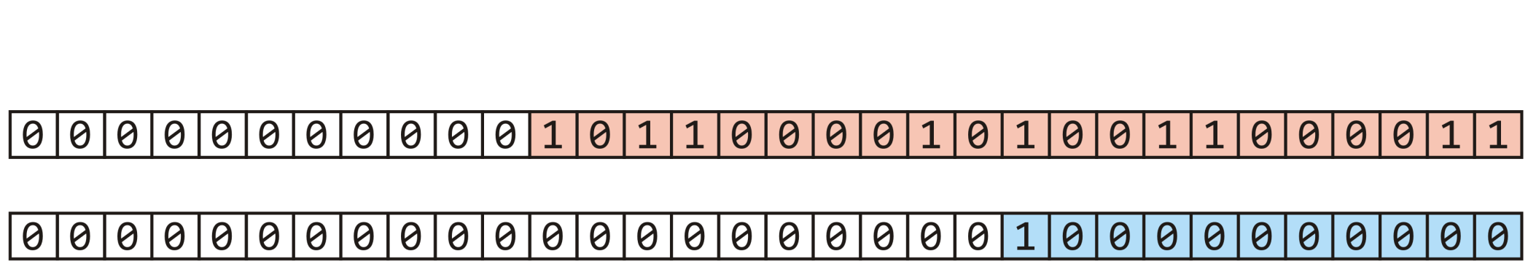

The multiplicative method
9.3.3.1
m = 10
n = 42
Left shift 1 m = 10 bits yielding 2¹⁰
const unsigned int C = 581869333; // some number
unsigned int hash_M( unsigned int n, unsigned int m ) {
unsigned int shift = (32 – m)/2;
return ((C*n) >> shift) & ((1 << m) – 1);
}

Slide 25
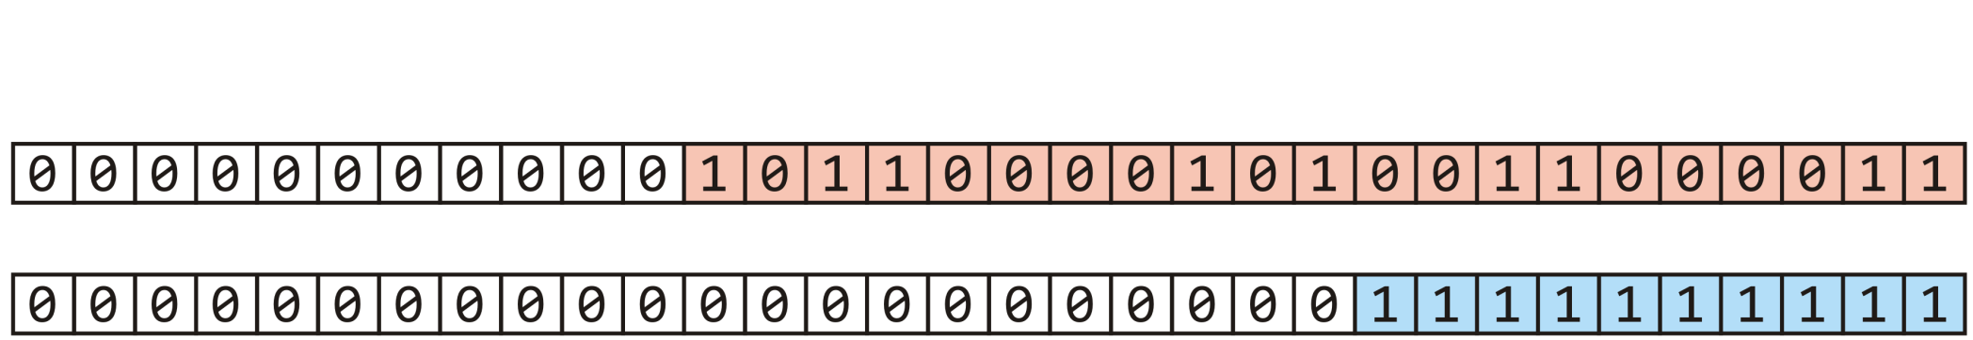
The multiplicative method
9.3.3.1
m = 10
n = 42
Subtracting 1 yields m = 10 ones
const unsigned int C = 581869333; // some number
unsigned int hash_M( unsigned int n, unsigned int m ) {
unsigned int shift = (32 – m)/2;
return ((C*n) >> shift) & ((1 << m) – 1);
}

Slide 26
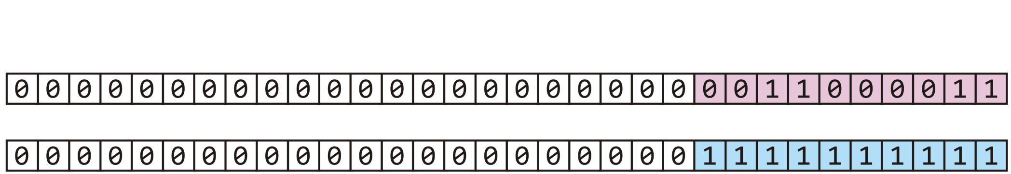
The multiplicative method
9.3.3.1
m = 10
n = 42
Taken the bitwise to clear all but the last 10 bits
const unsigned int C = 581869333; // some number
unsigned int hash_M( unsigned int n, unsigned int m ) {
unsigned int shift = (32 – m)/2;
return ((C*n) >> shift) & ((1 << m) – 1);
}

Slide 27
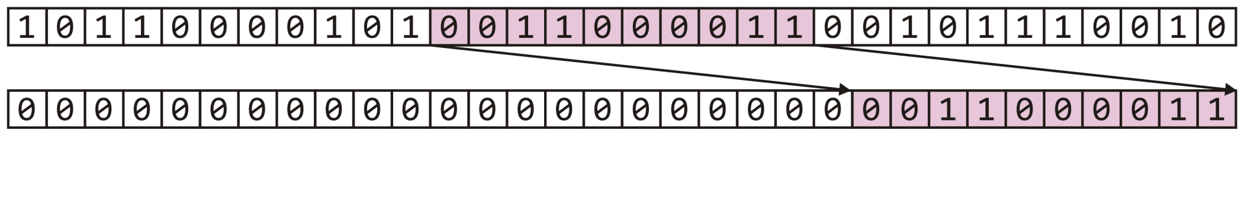
The multiplicative method
9.3.3.1
We have extracted the middle m = 10 bits—a number in 0, …, 1023
const unsigned int C = 581869333; // some number
unsigned int hash_M( unsigned int n, unsigned int m ) {
unsigned int shift = (32 – m)/2;
return ((C*n) >> shift) & ((1 << m) – 1);
}
h_{M}(42) = 195

Slide 28
Dealing with signed integers
9.3.4
In some cases (Java) unsigned integers are either not available
Our function would be implemented as follows:
int hash_M( int n, int M ) {
return n % M;
}
Is this sufficient to yield a value on 0, ..., M – 1?

Slide 29
Dealing with signed integers
9.3.4
The modulus operator % satisfies the following equality:
n == M*(n/M) + n%M
The division operator n/M truncates any factional part
It rounds towards zero
For positive n and M, this yields positive values:
If n = 13 and M = 8, 13/8 → 1 and 8*1 → 8
∴ 13 % 8 → 5
For a negative value of n:
If n = -11 and M = 8, -11/8 → -1 and 8*(-1) = -8
∴(-11) % 8 → -3

Slide 30
Dealing with signed integers
9.3.4
Our mapping function could be implemented as follows:
int hash_M( int n, int M ) {
int hash_value = n % M;
return (hash_value >= 0) ? hash_value : hash_value + M;
}

Slide 31
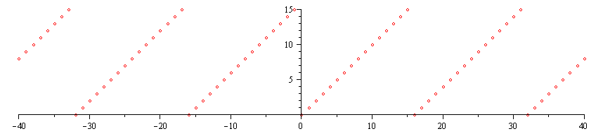
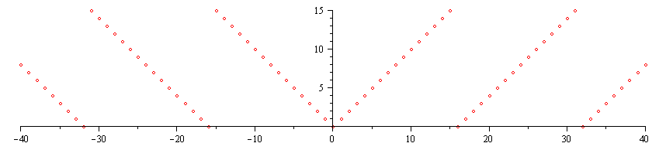
Dealing with signed integers
9.3.4
Why + M and not std::abs( M )?
First, adding results in periodicity:
Using the absolute value is not periodic

Slide 32
Dealing with signed integers
9.3.4
Also, not all integers have absolute values:
int main() {
int n1 = -2147483648; // -2^31
int n2 = -2147483647; // -(2^31 – 1)
cout << std::abs( n1 ) << endl;
cout << std::abs( n2 ) << endl;
return 0;
}
The output is:
-2147483648
2147483647

Slide 33
Summary
This topic covered next step in creating a hash value:
Taking a 32-bit number and mapping it down to 0, …, M – 1
One can use the modulus; however, using the middle m bits of the number times a large prime avoids some weaknesses of the modulus
We must now deal with collisions: the reality that two objects may hash to the same value

Slide 34
References
Wikipedia, http://en.wikipedia.org/wiki/Hash_function
[1] Cormen, Leiserson, and Rivest, Introduction to Algorithms, McGraw Hill, 1990.
[2] Weiss, Data Structures and Algorithm Analysis in C++, 3rd Ed., Addison Wesley.
These slides are provided for the ECE 250 Algorithms and Data Structures course. The material in it reflects Douglas W. Harder’s best judgment in light of the information available to him at the time of preparation. Any reliance on these course slides by any party for any other purpose are the responsibility of such parties. Douglas W. Harder accepts no responsibility for damages, if any, suffered by any party as a result of decisions made or actions based on these course slides for any other purpose than that for which it was intended.

